Slide 1
Software engineering module - i
Semester VI B.Tech. CSE Viswajyothi College of Engineering

Slide 2
Software
Computer software is the product that software engineers design and build.
It encompasses
Instructions (computer programs) that when executed provide desired function and performance,
Data structures that enable the programs to adequately manipulate information
Descriptive information in both hard copy and virtual forms that describes the operation and use of the programs.
Software is a logical rather than a physical system element.

Slide 3
The evolving role of Software
Software takes on a dual role;
Product:- it delivers the computing potential embodied by computer hardware or, more broadly, a network of computers that are accessible by local hardware.
Vehicle for delivering a product:-
the basis for the control of the computer (operating systems)
the communication of information (networks)
the creation and control of other programs (software tools and environments).

Slide 4
Contnd..
The role has significant changes over a time span of little more than 50 years
Improvements-
in hardware performance
pro-found changes in computing architectures
vast increases in memory and storage capacity
a wide variety of exotic input and output options
The lone programmer of an earlier era has been replaced by a team of software specialists,
Each focusing on one part of the technology required to deliver a complex application.

Slide 5
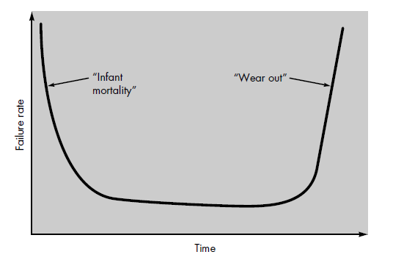
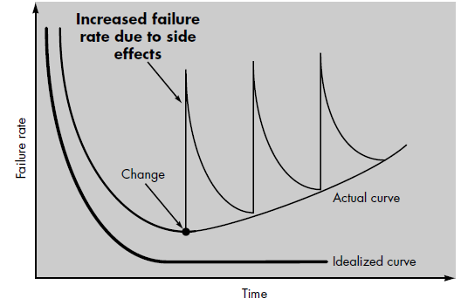
Software Characteristics
Software is developed or engineered, it is not manufactured in the classical sense like hardware.
Software doesn't "wear out.“
Hardware Software
software maintenance involves considerably more complexity than hardware maintenance.

Slide 6
Contnd..
Although the industry is moving toward component-based assembly, most software continues to be custom built.
In the hardware world, component reuse is a natural part of the engineering process.
Software components had a limited domain of application.
Modern reusable components encapsulate
Data
The processing applied to the data
e.g., graphical user interfaces

Slide 7
The changing Nature of Software & Software Applications
Key element in the evolution of computer-based systems and products.
Evolved from a specialized problem solving and information analysis tool to an industry in itself.
Limiting factor in the continuing evolution of computer-based systems.

Slide 8
Contnd..
System software
System software is a collection of programs written to service other programs.
e.g., compilers, editors, operating system components, drivers etc.
Real-time software
Software that monitors/analyzes/controls real-world events as they occur is called real time.
Business software
Business information processing
e.g., payroll, accounts receivable/payable, inventory

Slide 9
Engineering and scientific software
Applications range from astronomy to volcanology, from automotive stress analysis to space shuttle orbital dynamics, and from molecular biology to automated manufacturing
Embedded software
Embedded software resides in read-only memory and is used to control products and systems for the consumer and industrial markets.
e.g., digital functions in an automobile such as fuel control, dashboard displays, and braking systems
Personal computer software
Web-based software
Artificial intelligence software
AI software makes use of nonnumerical algorithms to solve complex problems
e.g., Expert systems, pattern recognition (image and voice), artificial neural networks, theorem proving, and game playing

Slide 10
Contnd..
Open-World Computing
Growth of wireless networking
Netsourcing
WWW- Computing Engine and content provider.
Open Source
Distribution of source code.

Slide 11
Legacy Software
Developed decades ago and have been continually modified.
Support core business functions.
Have long life and business criticality.
Costly to maintain and risky to evolve.
Exhibit poor quality
Complex code, poor documentation, poor testing, poor change management.

Slide 12
Contnd..
Reasons for Evolving of Legacy Software
Must be adapted to meet the needs of new computing environments or technology.
Must be enhanced to implement new business requirements
Must be changed because of errors found in the specification, design, or implementation.
Must be extended to make it interoperable with other more modern systems, databases or networks.
Must be re-architected to make it viable within a network environment.

Slide 13
Legacy System Components

Slide 14
Contnd..
Hardware - may be obsolete mainframe hardware.
Support software - may rely on support software from suppliers who are no longer in business.
Application software - may be written in obsolete programming languages.
Application data - often incomplete and inconsistent.
Business processes - may be constrained by software structure and functionality.
Business policies and rules - may be implicit and embedded in the system software.

Slide 15
Layered Model

Slide 16
Contnd..
Changes to one layer may require consequent changes to layers that are both above and below.
Reasons;
Introduction of new facilities, higher layers need to take advantage of these facilities.
Changes may slow down the system; new h/w needed to improve the system performance.
Changes in h/w makes it impossible to manage the interfaces.

Slide 17
Software Engineering
A concerted effort should be made to understand the problem before a software solution is developed.
Design becomes a pivotal activity.
Software should exhibit high quality.
Software should be maintainable.

Slide 18
Definition
The establishment and use of sound engineering principles in order to obtain economically software that is reliable and works efficiently on real machines.
The application of systematic, disciplined, quantifiable approach to the development, operation, and maintenance of software.
Software engineering is an engineering discipline that is concerned with all aspects of software production.

Slide 19
Contnd..
Software engineers should adopt
Systematic and organized approach to their work.
Use appropriate tools and techniques depending on the problem to be solved.
The development constraints and the resources available.
Challenge for Software Engineers
Produce high quality software
With finite amount of resources &
Within a predicted schedule

Slide 20
Software Engineering – Layered Technology
Layered Technology
Tools: CASE preferred
Methods: technical “how to’s”
Process model: the “framework”
A quality focus: the “bedrock”

Slide 21
Contnd..
A quality Focus
Every organization is rest on its commitment to quality.
Total quality management,
Six Sigma, or similar continuous improvement culture
Process:
It’s a foundation layer for software engineering.
It’s define framework for a set of key process areas (KRA) for effectively manage and deliver quality software in a cost effective manner
The basis for management control of software projects.
Establishes the context in which technical methods are applied,
Work products are produced,
Milestones are established,
Quality is ensured, and
Change is properly managed.

Slide 22
Contnd..
Methods:
It provide the technical how-to's for building software.
Methods encompass a broad array of tasks that include requirements analysis, design, program construction, testing, and support.
There could be more than one technique to perform a task and different techniques could be used in different situations.
Tools:
Provide automated or semi-automated support for the process, methods and quality control.
When tools are integrated so that information created by one tool can be used by another, a system for the support of software development, called computer-aided software engineering (CASE)

Slide 23
Process framework
Process Framework
Umbrella Activities
Software Process
Framework activities
work tasks
work products
milestones & deliverables
QA checkpoints
Process framework
Umbrella Activities
Framework activity 1
Each framework activities is populated by a set for software engineering actions – a collection of related tasks.
Each action has individual work task.
Framework activity n

Slide 24
Process framework
Why process :
A process defines who is doing what, when and how to reach a certain goal.
To build complete software process.
Identified a small number of framework activities that are applicable to all software projects, regardless of their size or complexity.
It encompasses a set of umbrella activities that are applicable across the entire software process.

Slide 25
Umbrella Activities
Software project tracking and control
Assessing progress against the project plan.
Take adequate action to maintain schedule.
Formal technical reviews
Assessing software work products in an effort to uncover and remove errors before goes into next action or activity.
Software quality assurance
Define and conducts the activities required to ensure software quality.
Software configuration management
Manages the effects of change.

Slide 26
Contnd..
Document preparation and production
Help to create work products such as models, documents, logs, form and list.
Reusability management
Define criteria for work product reuse
Mechanisms to achieve reusable components.
Measurement
Define and collects process, project, and product measures
Assist the team in delivering software that meets customer’s needs.
Risk management
Assesses risks that may effect that outcome of project or quality of product (i.e. software)

Slide 27
A generic view of process (Activities)
Five framework activities
Communication:
Heavy communication with customers, stakeholders, team
Understand the problem
Encompasses requirements gathering and related activities.
inception, elicitation, elaboration, negotiation, specification, and validation.
Planning:
Workflow that is to follow
Describe technical task, likely risk, resources will require, work products to be produced and a work schedule.

Slide 28
Contnd..
Modeling:
Help developer and customer to understand requirements (Analysis of requirements) & Design of software
Construction
Code generation: either manual or automated or both
Testing – to uncover error in the code.
Deployment:
Delivery to the customer.
Customer provide feedback after evaluation.

Slide 29
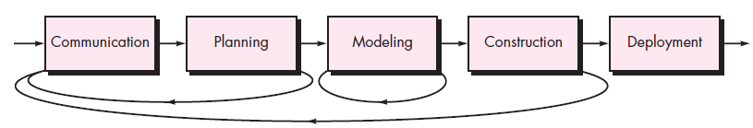
Process Flow
Describes how the framework activities and the actions and tasks that occur within each framework activity are organized with respect to sequence and time.
Linear process flow
Iterative process flow

Slide 30
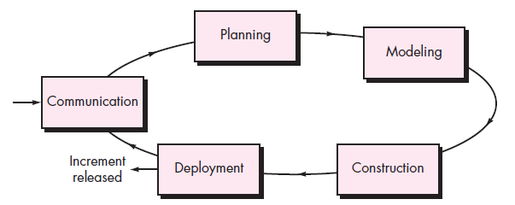
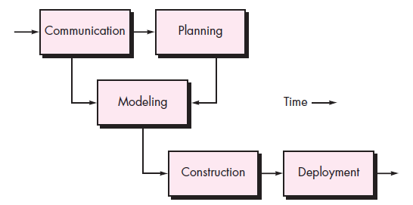
Contnd..
Evolutionary process flow
Parallel process flow

Slide 31
CASE (Computer-Aided Software Engineering)
Software systems that are intended to provide automated support for software process activities.
CASE systems are often used for method support.
Upper-CASE
Tools to support the early process activities of requirements and design;
Lower-CASE
Tools to support later activities such as programming, debugging and testing.

Slide 32
Software Process Model
Process models prescribe a distinct set of activities, actions, tasks, milestones, and work products required to engineer high quality software.
Process models are not perfect, but provide roadmap for software engineering work.
Software models provide stability, control, and organization to a process that if not managed can easily get out of control
Software process models are adapted to meet the needs of software engineers and managers for a specific project.

Slide 33
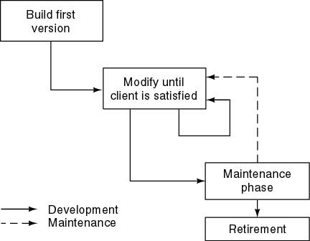
Build and Fix Model

Slide 34
Contnd..
The earlier approach
Product is constructed without specification or any attempt at design.
Developers simply build a product that is reworked as many times as necessary to satisfy the client.
Model may work for small projects but is totally unsatisfactory for products of any reasonable size.
Maintenance is high.
Source of difficulties and deficiencies
impossible to predict
impossible to manage

Slide 35
Why Models are Needed?
Symptoms of inadequacy: the software crisis
Scheduled time and cost exceeded
User expectations not met
Poor quality

Slide 36
Personal & Team Process Models
The Personal Software Process (PSP) emphasizes;
Personal measurement of both the work product that is produced and
the resultant quality of the work product.
PSP makes the practitioner responsible for
Project planning (e.g., estimating and scheduling) and
empowers the practitioner to control the quality of all software work products that are developed.
PSP emphasizes the need to record and analyze the types of errors you make, so you can develop strategies eliminate them.

Slide 37
Contnd..
PSP model Framework Activities
Planning
Isolates requirements and based on these develops both size & resource estimates.
A defect estimate is made.
Metrics are recorded
Development task identified and
Schedule is created.
High level Design
External specification of all components.
Prototypes are built.
All issues are recorded and tracked.

Slide 38
Contnd..
High level Design Review
Formal verification to uncover errors.
Metrics are maintained for all important tasks & work results.
Development
The component-level design is refined and reviewed.
Code is generated, reviewed, compiled, and tested.
Metrics are maintained for all important tasks and work results.
Postmortem
Effectiveness of process is determined an improved.
Using measures & metrics collected

Slide 39
Contnd..
Need to identify errors early, understand the types of errors that you are likely to make.
A disciplined, metrics-based approach to software engineering.
Significant improvement in software engineering productivity and software quality if applied properly.
Not been widely adopted throughout the industry.
Have more to do with human nature and organizational inertia than they do with the strengths and weaknesses of the PSP approach.
PSP is intellectually challenging and demands a level of commitment (by practitioners and their managers) that is not always possible to obtain.
Training is relatively lengthy, and training costs are high.
The required level of measurement is culturally difficult for many software people.

Slide 40
Contnd..
The Team Software Process (TSP)
build a “selfdirected” project team that organizes itself to produce high-quality software.
Objectives
Build self-directed teams that plan and track their work, establish goals, and own their processes and plans. These can be pure software teams or integrated product teams (IPTs) of 3 to about 20 engineers.
Show managers how to coach and motivate their teams and how to help them sustain peak performance.
Accelerate software process improvement by making CMM Level 5 behavior normal and expected.
Provide improvement guidance to high-maturity organizations.
Facilitate university teaching of industrial-grade team skills

Slide 41
Contnd..
TSP Framework Activities
Launch high level design
Implementation
Integration
Test
Postmortem
These activities enable the team to plan, design, and construct software in a disciplined manner while at the same time quantitatively measuring the process and the product.

Slide 42
Contnd..
To guide team members in their work TSP Uses a wide variety of;
Scripts- Specific process activities and other more detailed work functions
Forms, and Standards
The team must;
Make a full commitment to the process
Must undergo thorough training.

Slide 43
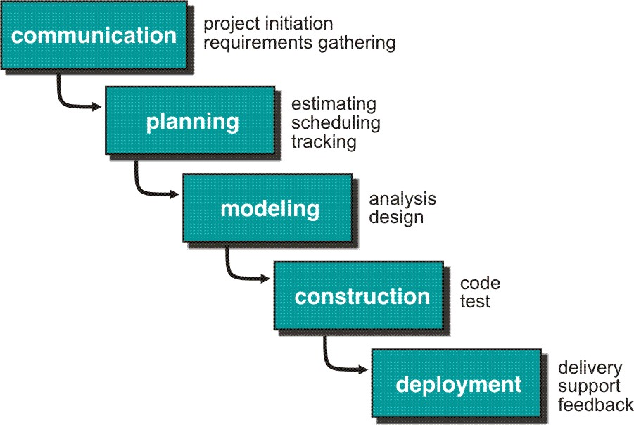
Process Models- Prescriptive Models
Waterfall Model (classic life cycle, linear sequential model)
Suggests a systematic, sequential approach to software development.
Concrete requirements.
Appropriate when the requirements are well-understood and changes will be fairly limited during the design process.

Slide 44
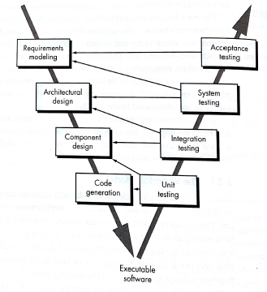
The V- Model

Slide 45
Limitations of the waterfall model
Real projects are rarely follow the sequential model.
Difficult for the customer to state all the requirement explicitly.
Assumes patience from customer - working version of program will not available until late in the project life span.
Some teams sit ideal for other teams to finish
The model implies that you should attempt to complete a given stage before moving on to the next stage.
The model implies that once the product is finished, everything else is maintenance.
Delivers a large amount of work products.

Slide 46
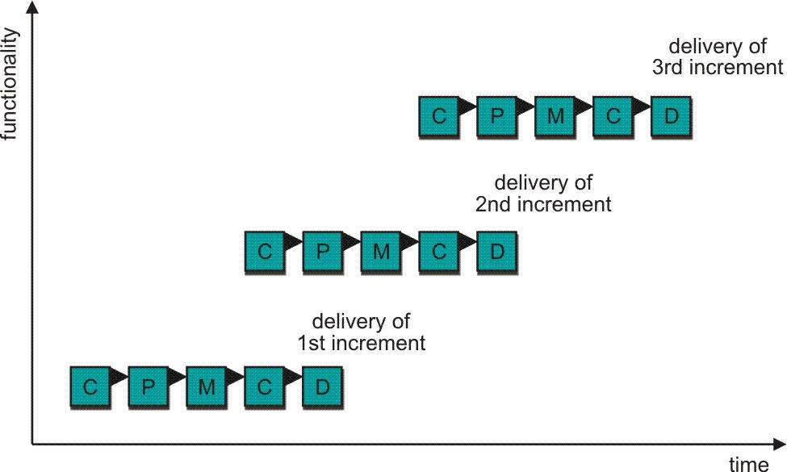
Incremental Process Model
Rather than deliver the system as a single delivery, the development and delivery is broken down into increments with each increment delivering part of the required functionality.
C- Communication
P - Planning
M – Modeling
C - Construction
D - Deployment

Slide 47
Contnd..
First Increment is often core product
Includes basic requirement
Many supplementary features (known & unknown) remain undelivered
A plan of next increment is prepared
Modifications of the first increment
Additional features of the first increment
Incremental model focus more on delivery of operation product with each increment

Slide 48
Contnd..
User requirements are prioritised and the highest priority requirements are included in early increments.
Once the development of an increment is started, the requirements are frozen though requirements for later increments can continue to evolve.
Customer value can be delivered with each increment so system functionality is available earlier.
Early increments act as a prototype to help elicit requirements for later increments.

Slide 49
Contnd..
Increment can be planned to manage technical risks.
Lower risk of overall project failure.
The highest priority system services tend to receive the most testing.
It is particularly useful when enough staffing is not available for the whole project

Slide 50
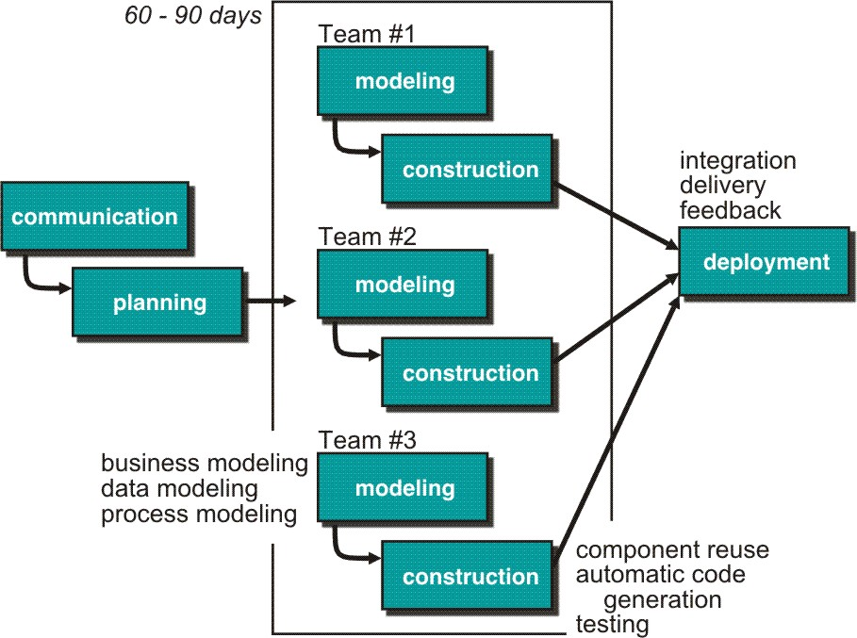
Rapid Application Development (RAD) Model
Rapid application development (RAD) is an incremental software development process model that emphasizes an extremely short development cycle.

Slide 51
Contnd..
Communication – to understand business problem.
Planning – multiple s/w teams works in parallel on diff. system.
Modeling –
Business modeling – Information flow among business is working.
Ex. What kind of information drives?
Who is going to generate information?
From where information comes and goes?
Data modeling – Information refine into set of data objects that are needed to support business.
Process modeling – Data object transforms to information flow necessary to implement business.

Slide 52
Construction – Highlighting the use of pre-existing software component.
Deployment – Deliver to customer basis for subsequent iteration.
RAD model emphasize a short development cycle.
“High speed” edition of linear sequential model.
If requirement are well understood and project scope is constrained then it enable development team to create “ fully functional system” within a very short time period.
Makes heavy use of reusable software components with an extremely short development cycle
Each major function can be addressed by a separate team and then integrated to form a whole.

Slide 53
Contnd..
Drawback:
For large but scalable projects
RAD requires sufficient human resources
Projects fail if developers and customers are not committed in a much shortened time-frame
Problematic if system can not be modularized
Not appropriate when technical risks are high (heavy use of new technology)

Slide 54
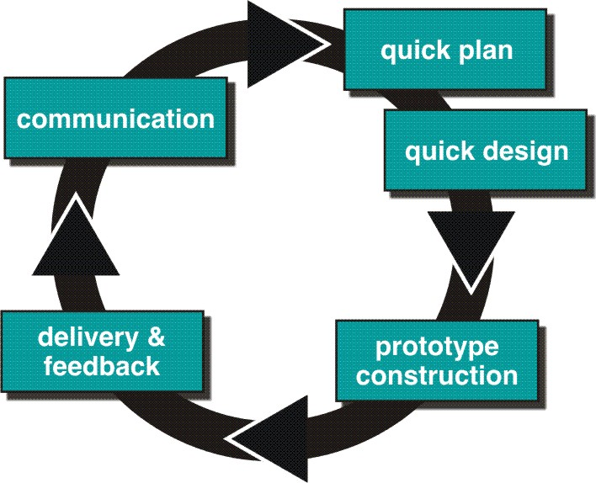
Evolutionary Process Models
Prototyping Model

Slide 55
Contnd..
Prototype can be serve as “the first system”.
Both customers and developers like the prototyping paradigm.
Customer/End user gets a feel for the actual system
Developer get to build something immediately.
Prototype
Throwaways
Evolutionary

Slide 56
Contnd..
Best approach when:
Objectives defines by customer are general but does not have details like input, processing, or output requirement.
Developer may be unsure of the efficiency of an algorithm, O.S., or the form that human machine interaction should take.
It can be used as standalone process model, but commonly used as a technique within the context of any other process model.
Model assist software engineer and customer to better understand what is to be built when requirement are fuzzy.

Slide 57
Contnd..
Prototyping start with communication, between a customer and software engineer to define overall objective, identify requirements and make a boundary.
Going ahead, planned quickly and modeling (software layout visible to the customers/end-user) occurs.
Quick design leads to prototype construction.
Prototype is deployed and evaluated by the customer/user.
Feedback from customer/end user will refine requirement and that is how iteration occurs during prototype to satisfy the needs of the customer.

Slide 58
Problem Areas
Customer cries foul and demand that “a few fixes” be applied to make the prototype a working product, due to that software quality suffers as a result.
Developer often makes implementation in order to get a prototype working quickly without considering other factors in mind like OS, Programming language, etc.

Slide 59
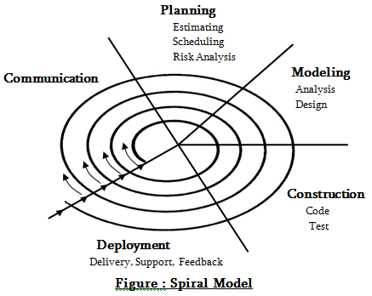
Spiral Model
Couples iterative nature of prototyping with the controlled and systematic aspects of the linear sequential model.

Slide 60
Contnd..
It provide potential for rapid development of increasingly more complete version of the software.
Using spiral, software developed in as series of evolutionary release.
Early iteration, release might be on paper or prototype.
Later iteration, more complete version of software.
Divided into framework activities (C,P,M,C,D). Each activity represent one segment.
Evolutionary process begins in a clockwise direction, beginning at the center.
Risk is considered as each revolution is made.

Slide 61
Contnd..
First circuit around the spiral might result in development of a product specification. Subsequently, develop a prototype and then progressively more sophisticated version of software.
Each pass through the planning region results in adjustments to the project plan.
Unlike other process models that end when software is delivered.
It can be adapted to apply throughout the life of software.

Slide 62
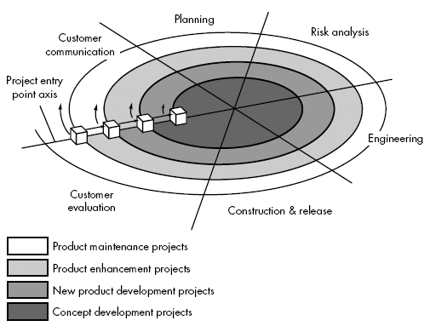
Contnd..

Slide 63
Concept Development Project:
Start at the core and continues for multiple iterations until it is complete.
If concept is developed into an actual product, the process proceeds outward on the spiral.
New Product Development Project:
New product will evolve through a number of iterations around the spiral.
Later, a circuit around spiral might be used to represent a “Product Enhancement Project”
Product Enhancement Project:
There are times when process is dormant or software team not developing new things but change is initiated, process start at appropriate entry point.
Product Maintenance Project:
Once the product is deployed maintenance phase is represented as a circuit around the spiral.

Slide 64
Contnd..
Spiral models uses prototyping as a risk reduction mechanism but, more important, enables the developer to apply the prototyping approach at each stage in the evolution of the product.
It maintains the systematic stepwise approach suggested by the classic life cycle but also incorporates it into an iterative framework activity.
If risks cannot be resolved, project is immediately terminated
Problem Area:
It may be difficult to convince customers (particularly in contract situations) that the evolutionary approach is controllable.
If a major risk is not uncovered and managed, problems will undoubtedly occur.

Slide 65
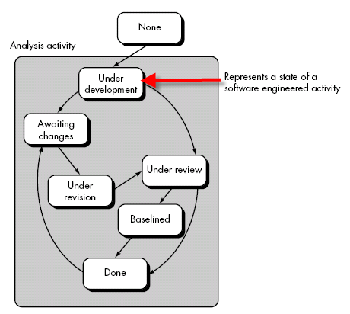
The Concurrent Development Model
Represents iterative and concurrent elements of any of the process models.

Slide 66
Contnd..
Defines a series of events that will trigger transitions from state to state for each of the software engineering activities, actions, or tasks.
It is often more appropriate for system engineering projects where different engineering teams are involved.
The activity-modeling may be in any one of the states for a given time.

Slide 67
Contnd..
All activities exist concurrently but reside in different states.
E.g. The analysis activity (existed in the none state while initial customer communication was completed) now makes a transition into the under development state.
Analysis activity moves from the under development state into the awaiting changes state only if customer indicates changes in requirements.
Series of event will trigger transition from state to state.
E.g. During initial stage there was inconsistency in design which was uncovered. This will triggers the analysis action from the Done state into Awaiting Changes state.

Slide 68
Contnd..
Visibility of current state of project
It define network of activities
Each activities, actions and tasks on the network exists simultaneously with other activities, actions and tasks.
Events generated at one point in the process network trigger transitions among the states.

Slide 69
Specialized Process Models
Component Based Development
Component-based development (CBD) model incorporates many of the characteristics of the spiral model.
It is evolutionary by nature and iterative approach to create software.
CBD model creates applications from prepackaged software components (called classes).

Slide 70
Steps of CBD
Available Component Based products are researched and evaluated for the application domain in question
Component integration issues are considered.
A s/w architecture is designed to accommodate the components
Components are integrated into the architecture
Comprehensive testing is conducted to ensure proper functionality.

Slide 71
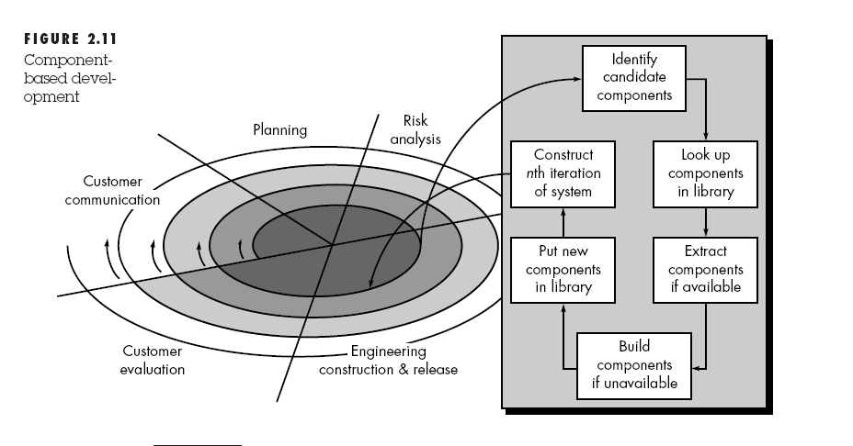

Slide 72
Contnd..
CBD model leads to software reusability
Based on studies, CBD model leads to 70 % reduction in development cycle time.
84% reduction in project cost.
Productivity is very high.

Slide 73
THE FORMAL METHODS MODEL
Encompasses a set of activities that leads to formal mathematical specification of computer software.
Enable a software engineer to specify, develop, and verify a computer-based system by applying a rigorous, mathematical notation.
A variation on this approach, called cleanroom software engineering.
Ambiguity, incompleteness, and inconsistency can be discovered and corrected more easily, not through ad hoc review but through the application of mathematical analysis.
Offers the promise of defect-free software.

Slide 74
Contnd..
Problems
The development of formal models is currently quite time consuming and expensive.
Because few software developers have the necessary background to apply formal methods, extensive training is required.
It is difficult to use the models as a communication mechanism for technically unsophisticated customers.
Best Suited for;
safety-critical software

Slide 75
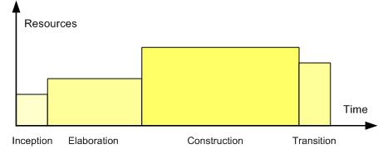
The Unified Process
The Unified Process is an iterative and incremental development process.

Slide 76
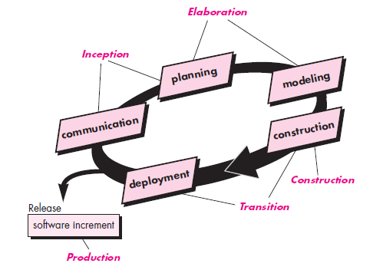
Contnd..

Slide 77
The UP organizes work and iterations across five major phases
Inception – approximate vision, business case, scope, vague estimates.
NOT a requirements phase, but a feasibility phase.
Encompasses both customer communication and planning activities
A rough architecture for the system
A tentative outline of major subsystems and the function and features that populate them
A plan for the iterative, incremental nature.
Identifies resources, assesses major risks, defines a schedule, and establishes a basis for the phases that are to be applied as the software increment is developed.
Fundamental business requirements ->a set of preliminary use cases

Slide 78
Contnd..
Elaboration – refined vision, iterative implementation of the core architecture, resolution of high risks, identification of most requirements and scope, more realistic estimates.
Encompasses the communication and modeling activities of the generic process model.
Refines and expands the preliminary use cases
A phase where the core architecture is iteratively designed and implemented.
Five different views of the software—
The use case model, the requirements model, the design model, the implementation model, and the deployment model.
Some cases, elaboration creates an “executable architectural baseline”

Slide 79
Contnd..
Construction – iterative implementation of the remaining lower risk and easier elements, preparation for deployment.
Requirements and design models that were started during the elaboration phase are completed.
All necessary and required features and functions for the software increment are then implemented in source code.
Unit tests are designed and executed for each.
Integration activities are conducted.
Use cases are used to derive a suite of acceptance tests that are executed.

Slide 80
Contnd..
Transition – beta tests and deployment
The software team creates the necessary support information.
The software increment becomes a usable software release.
Production - Coincides with the deployment activity of the generic process.
The ongoing use of the software is monitored,
Support for the operating environment (infrastructure) is provided,
Defect reports and requests for changes are submitted and evaluated.

Slide 81
Capability Maturity Model Integration (CMMI)
The Software Engineering Institute (SEI) has developed process meta-model to measure organization different level of process capability and maturity as a complete SPI framework.
A comprehensive process meta-model that is predicated on a set of system and software engineering capabilities that should be present as organizations reach different levels of process capability and maturity.
CMMI represents a process meta-model in two different ways:
A “continuous” model
A “staged” model.
Notes:
SPI-Software Process Improvement

Slide 82
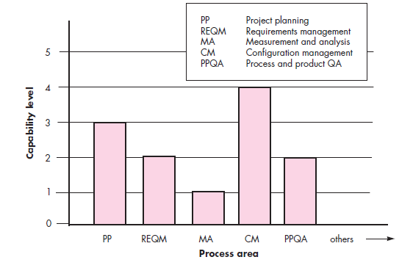
A “Continuous” Model
Each process area (e.g., project planning or requirements management) is formally assessed against specific goals and practices and is rated.

Slide 83
Contnd..
Level 0: Incomplete
The process area (e.g., requirements management) is either not performed or does not achieve all goals and objectives defined by the CMMI for level 1 capability for the process area.
Level 1: Performed
All of the specific goals of the process area (as defined by the CMMI) have been satisfied.
Work tasks required to produce defined work products are being conducted.
Level 2: Managed
All capability level 1 criteria have been satisfied.
In addition, all work associated with the process area conforms to an organizationally defined policy;
All people doing the work have access to adequate resources to get the job done;
Stakeholders are actively involved in the process area as required;
All work tasks and work products are “monitored, controlled, and reviewed; and are evaluated for adherence to the process description” .

Slide 84
Contnd..
Level 3: Defined
All capability level 2 criteria have been achieved.
In addition, the process is “tailored from the organization’s set of standard processes according to the organization’s tailoring guidelines, and contributes work products, measures, and other process-improvement information to the organizational process assets”.
Level 4: Quantitatively managed
All capability level 3 criteria have been achieved.
In addition, the process area is controlled and improved using measurement and quantitative assessment.
“Quantitative objectives for quality and process performance are established and used as criteria in managing the process”.
Level 5: Optimized
All capability level 4 criteria have been achieved.
In addition, the process area is adapted and optimized using quantitative (statistical) means to meet changing customer needs and to continually improve the efficacy of the process area under consideration.

Slide 85
Contnd..
The CMMI defines each process area in terms of “specific goals” and the “specific practices” required to achieve these goals.
Specific goals establish the characteristics that must exist if the activities implied by a process area are to be effective.
Specific practices refine a goal into a set of process-related activities

Slide 86
Contnd..
The staged CMMI model defines five maturity levels, rather than five capability levels.
To achieve a maturity level, the specific goals and practices associated with a set of process areas must be achieved.
The relationship between maturity levels and process areas are;

Slide 87
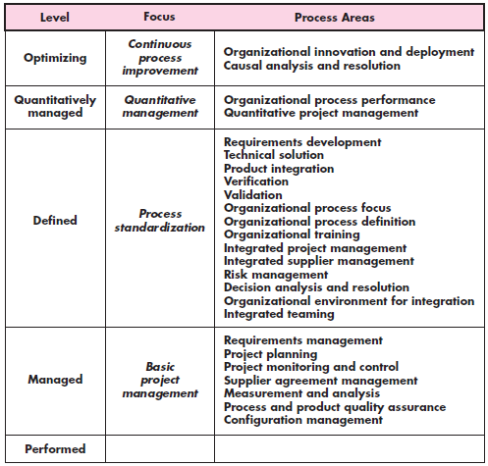

Slide 88
Contnd..
Each of the KPAs is defined by a set of key practices that contribute to satisfying its goals.
The key practices are policies, procedures, and activities that must occur before a key process area has been fully instituted.
The SEI defines key indicators as "those key practices or components of key practices that offer the greatest insight into whether the goals of a key process area have been achieved."
Assessment questions are designed to probe for the existence of a key indicator.

